Slide 1
Facts and Myths about Lodge Numbers and BSA National Policy
by Robert Higgins, webmaster
OA Section List
Copyright © 2015-23. All rights reserved.

Slide 2
Rumors and misconceptions
In 2004, National issued the infamous Operations Update regarding lodge numbers. Not only did it cause a minor uproar in some circles, it created even more confusion.
Even after almost 20 years, we still hear these myths:
“Lodge numbers aren't official anymore”
“We're supposed to be using our council's number”
“New lodges can't choose a lodge number”
All wrong, plain and simple.
What does the Update actually say…

Slide 3
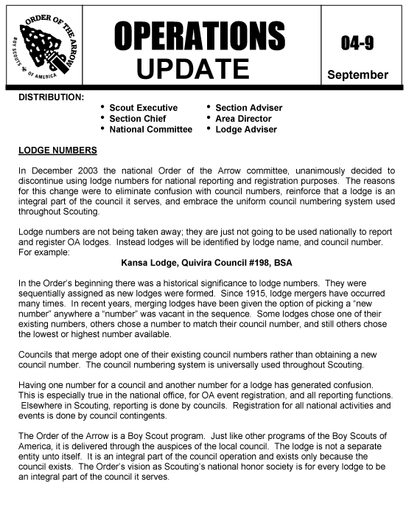
1
2

Slide 4
“Lodge
numbers
are
not
being
taken
away”

Slide 5
Update: what it did and did not say
Yes, National does not recognize lodge numbers,
but it doesn’t prohibit them either-- at least the local or section level
“Lodge numbers are not being taken away; they are just not going to be used nationally to report and register OA lodges. ”
Lodge numbers can’t be used on charters, official forms, registrations.
However, nothing prevents lodges from using it in other ways, such as patches, memorabilia, clothing, websites, newsletters, promotional materials, etc.

Slide 6
1
2
3

Slide 7
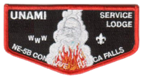
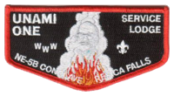
Update: what it did and did not say
“Lodges will be identified by lodge name, and council [name and] number.”
This is for charters, event registrations, forms, reporting and records.
This does NOT mean that a lodge should use its council number as if it were its lodge number.
Do you really think that Unami would change its number?
525

Slide 8
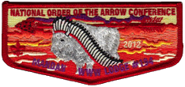
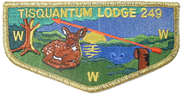
Mandan Lodge #194?
And yet, this misconception still persists:
Mandan Lodge #372 started to use 194– which is Orca’s number– from 2005 to as recently as 2013… and perhaps even still.
Tisquantum Lodge #164 used 249 during 2005. Spe-Le-Yai Lodge #249 was not pleased. In any case, they switched back by 2006.

Slide 9
New Lodges
What about lodges chartered after 2004? Some have argued that since they were never chartered with a number to begin with, they’re not supposed to pick a new one.
Since then, only ten lodges, Buffalo Mountain, Catamount, Erielhonan, I-Tsu-La, Kishahtek, Kon Wapos, Nataepu Shohpe, Pocumtuc, and Tschipey Achtu lodges, have chosen to not select a lodge number.
However, as many as 32 other new lodges have explicitly chosen a lodge number. Four have even chosen their council’s number as their lodge number– but without conflicting with any other lodge.

Slide 10
For more details on this topic:
www.oasections.com/lodgenos.html

